Slide 1
Exploratory data Analysis
By: Team 5
Akash Jagtap
Jerin Rajan
Nitin PrinceReuben

Slide 2
Data Analysis
Data - https://github.com/LuisM78/Appliances-energy-prediction-data
Data can be found in ‘csv’ file. It has data of temperature details and humidity details of 8 rooms inside the house. It also consist data like windspeed , visibility , temperature outside and pressure. Data has to be analyzed before proceeding for performing predictions with algorithms.

Slide 3

Analysis
We can see that the dataset contains 29 columns and 19,735 rows.

Slide 4
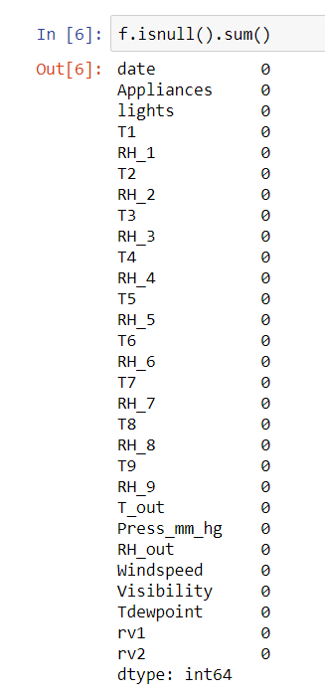
We can see that there isn’t any null or missing data in our dataset.

Slide 5
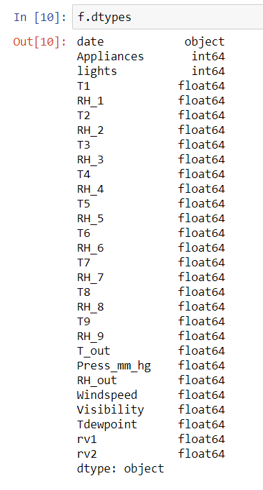
We can see that all our data is in the format of ‘float’. This makes it easy for us perform mathematical calculations.

Slide 6
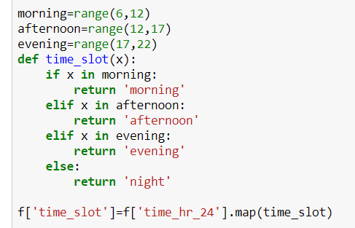
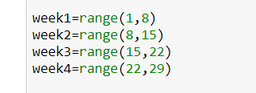
We are diving the time into four groups. Morning, afternoon, evening and night. In the same way, we are categorizing the days into weeks as first 7 days are week 1, 2nd 7 days are week 2 and so on. This is just categorizing of data which would help us analyze data easily.

Slide 7
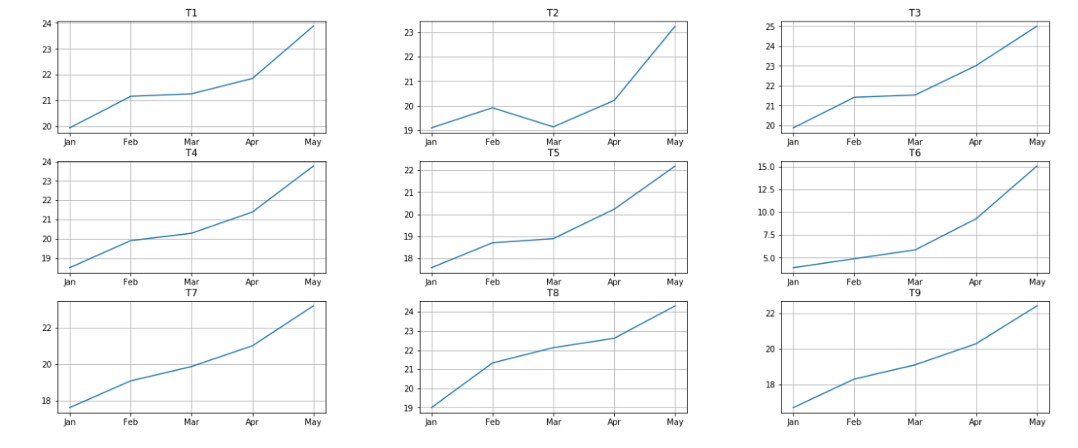
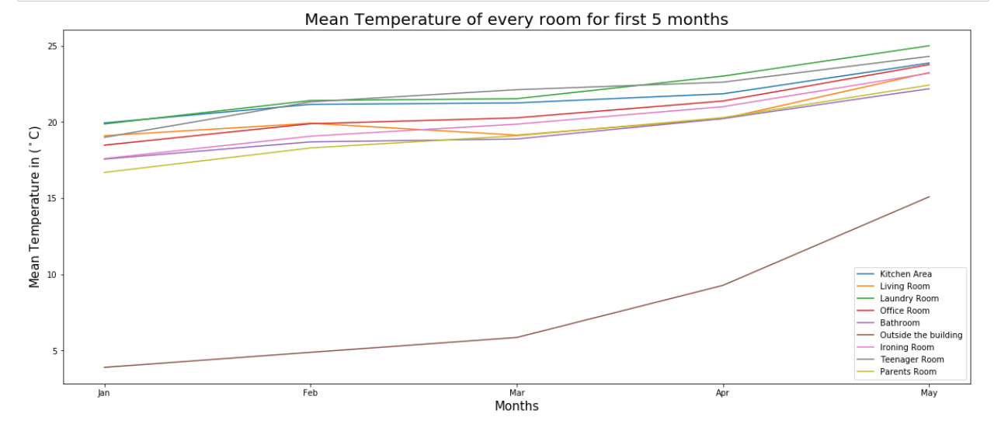
Change of mean temperature over the period

Slide 8
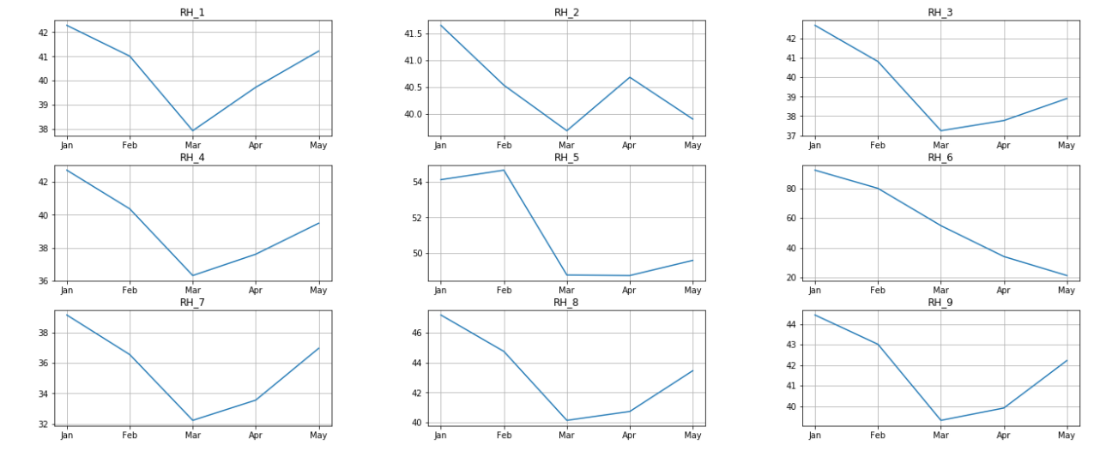
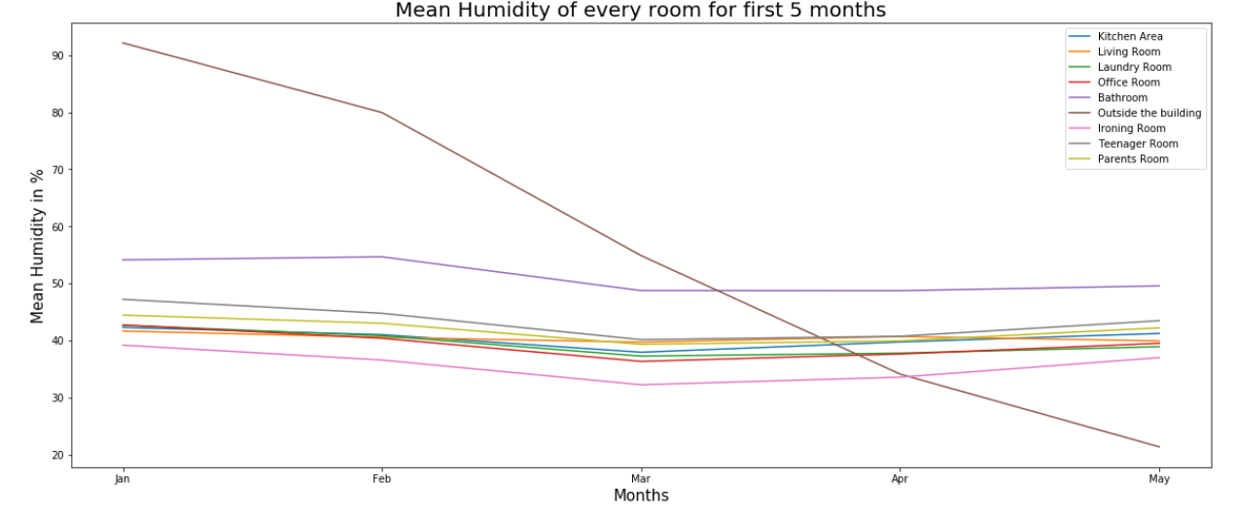
Change of mean temperature over the period

Slide 9
There are 6 other features present in dataset which are: Outside temperature, outside Pressure, outside Humidity, Windspeed, visibility and total dew point. Let’s plot each of them in individual graphs to understand their characteristics.

Slide 10
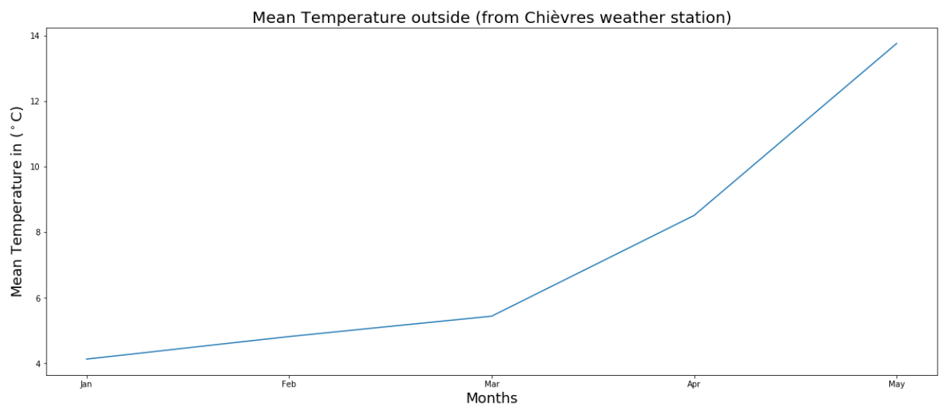
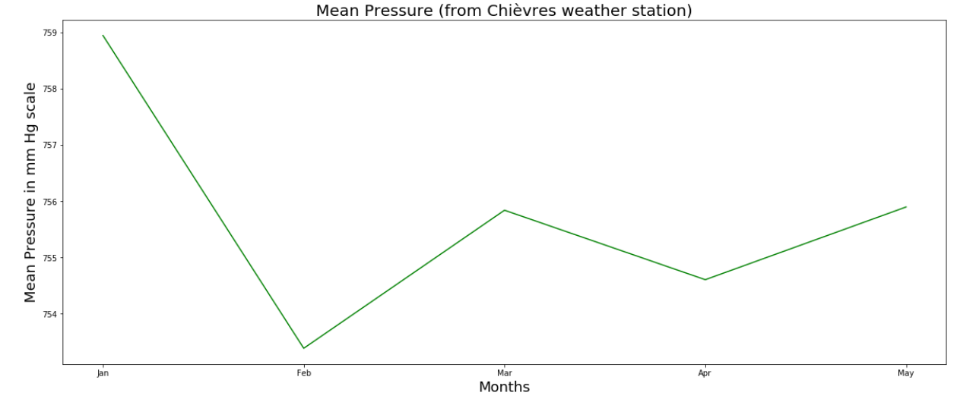
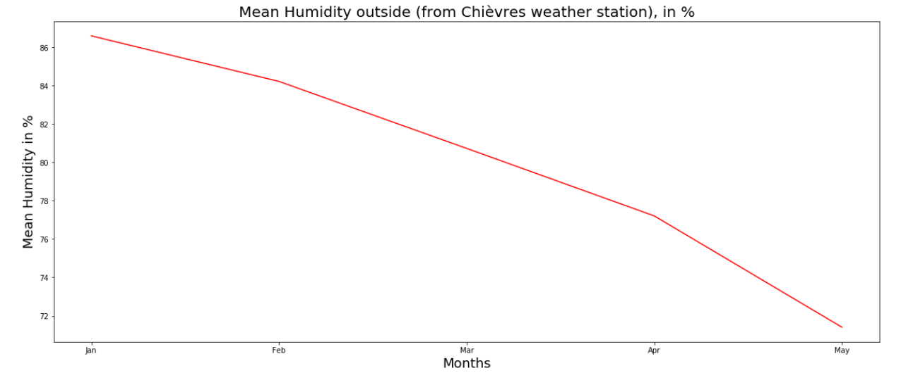

Slide 11
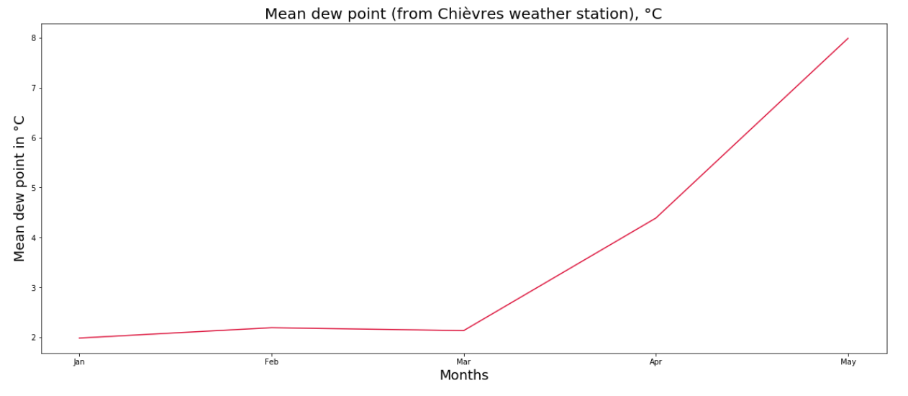
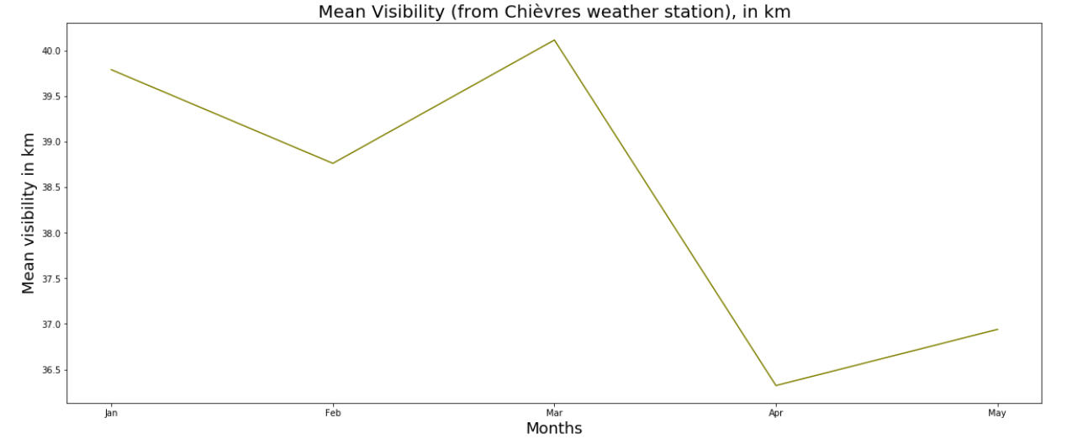
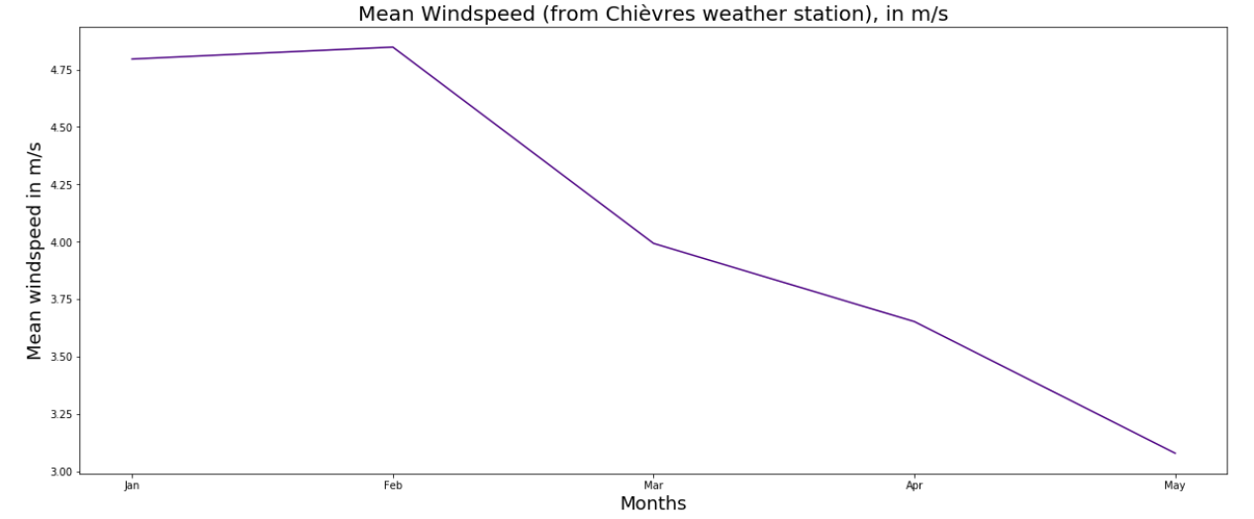

Slide 12
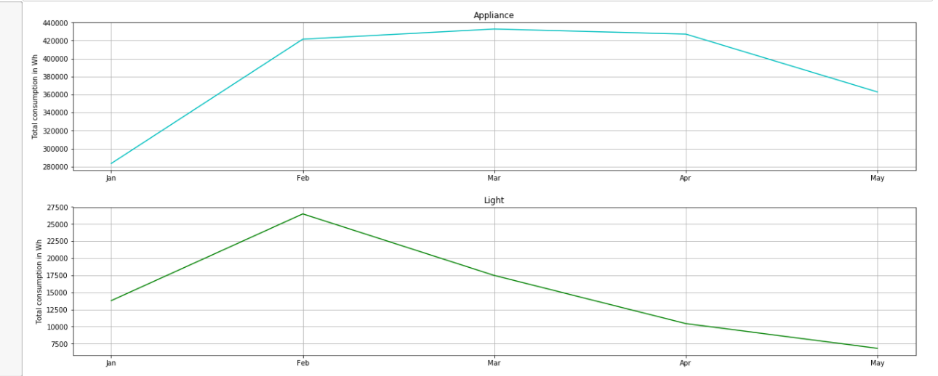
We will now try to find the total consumption of energy by 'lights' and all the ‘appliances’ at home.

Slide 13
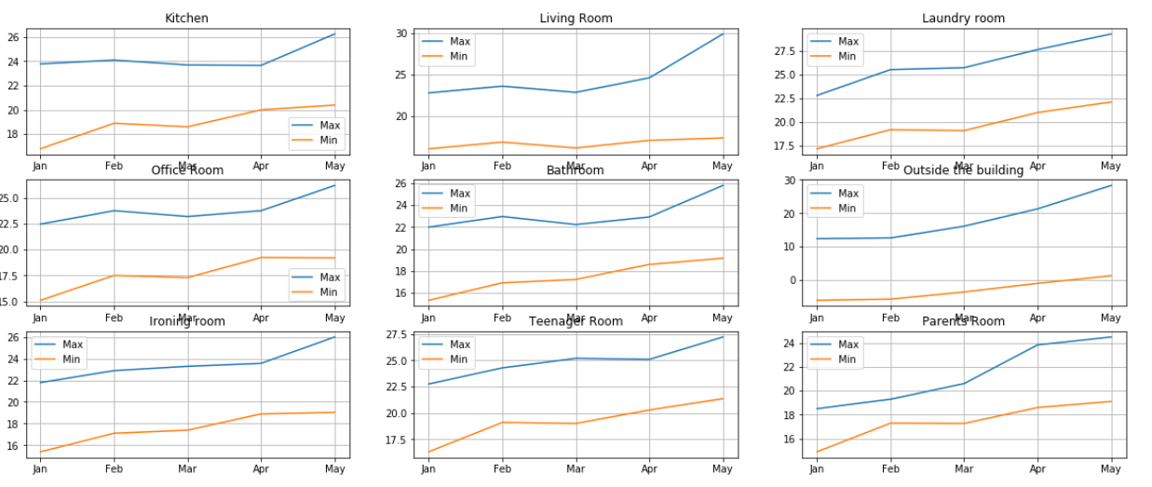
The temperature and humidity is varying a lot over the given period. We should also analyze deviation between minimum and maximum values of these over the period

Slide 14
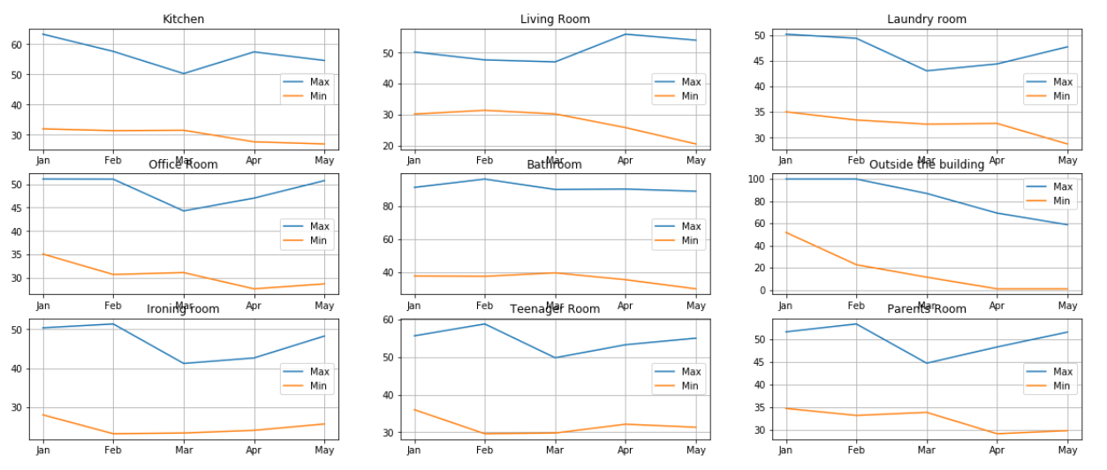

Slide 15
It is important to understand the change in mean of temperature with respect to others and over the period. So, we are comparing mean of temperature in 3 rooms at one time with months.

Slide 16
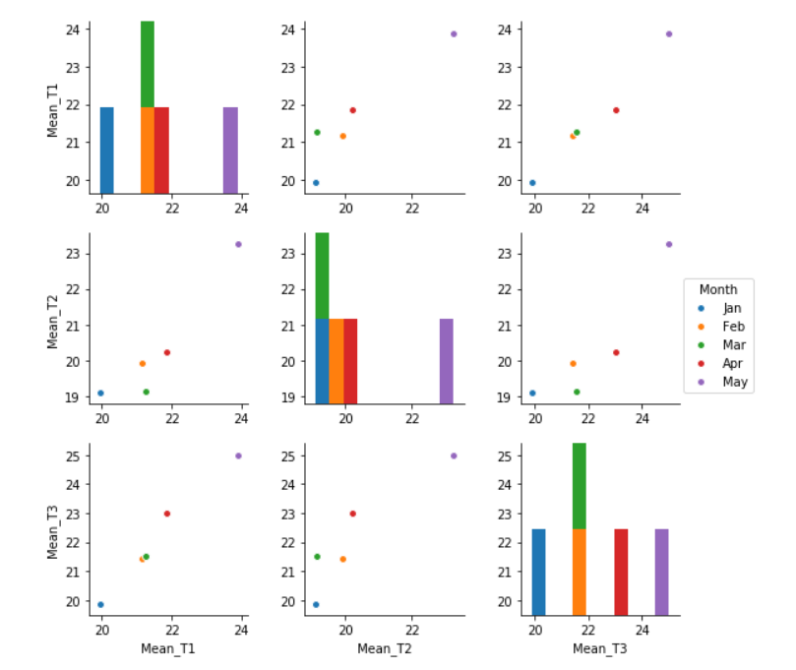

Slide 17
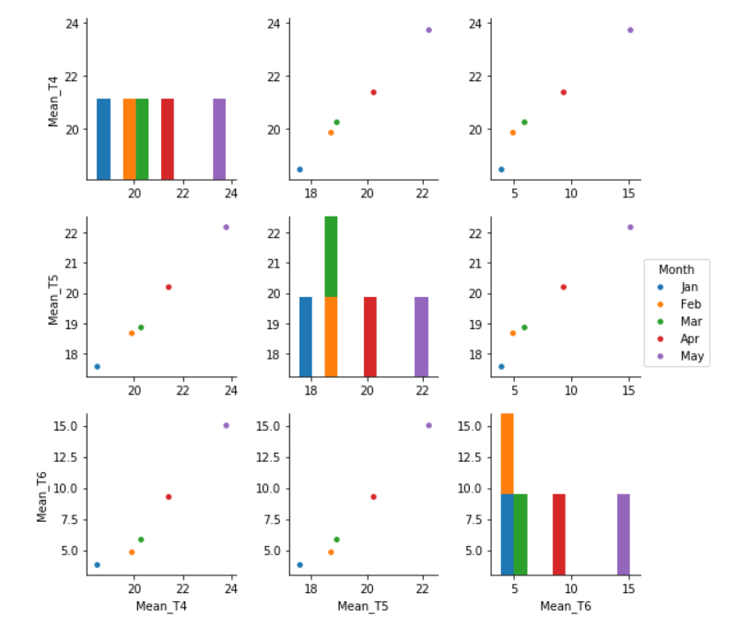

Slide 18
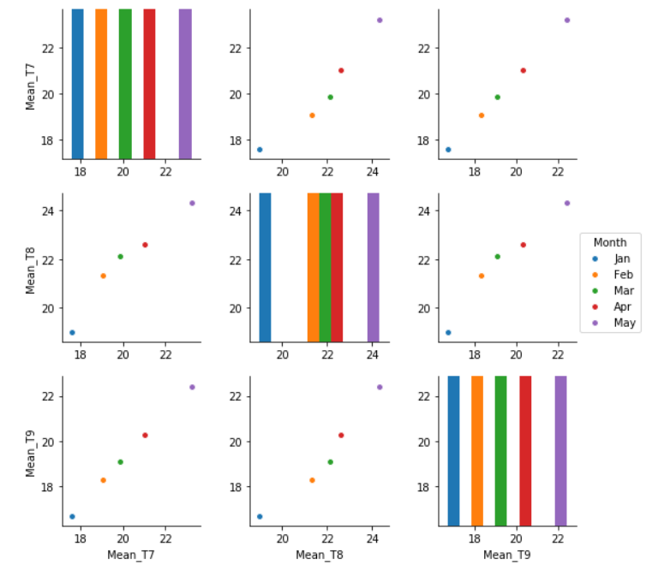

Slide 19
Similarly, comparing the change in mean of humidity of 3 room at a time with respect to months.

Slide 20
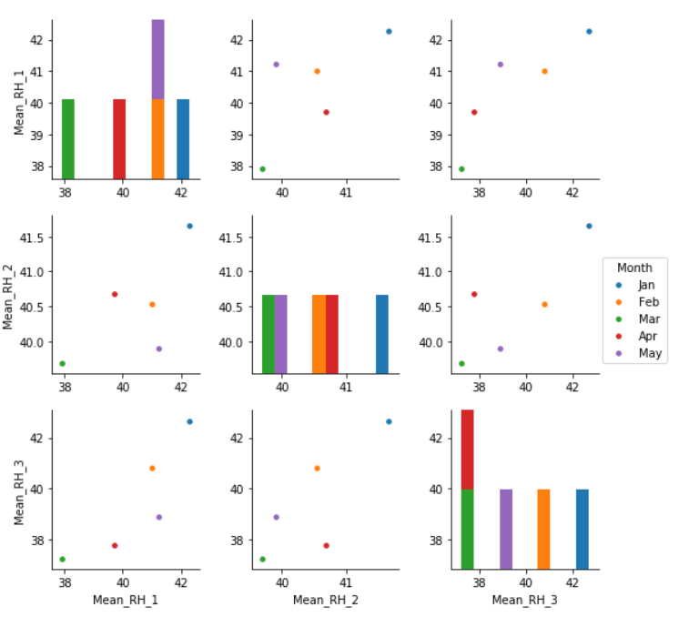

Slide 21
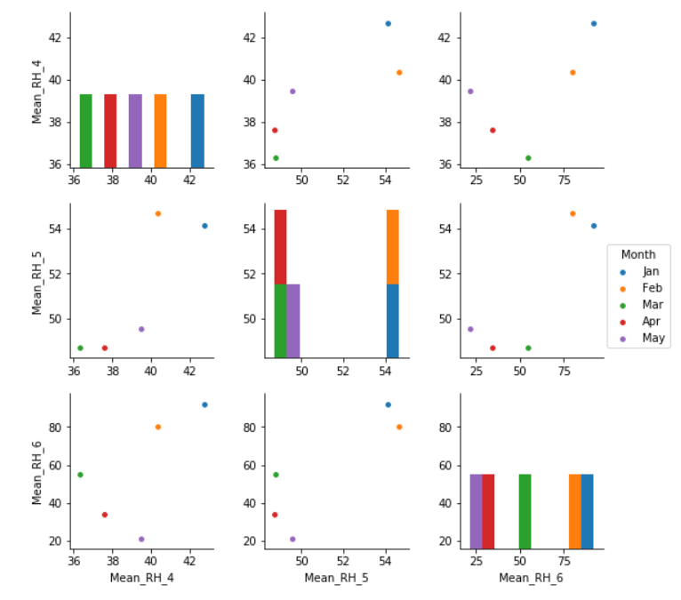

Slide 22
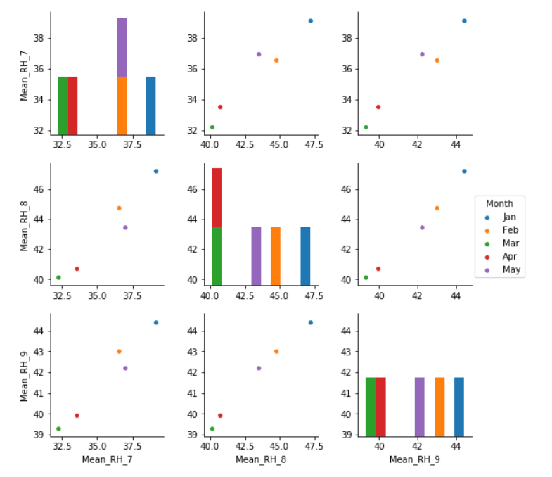

Slide 23
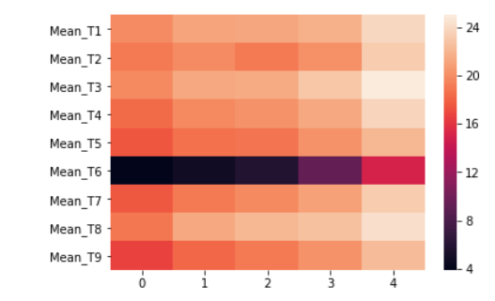
Let's try to understand the pattern of change in mean temperature through a heat map.

Slide 24
When we see the above graphs of data, we can understand the pattern. Also, we get a view of how the data is varying and which features would be important to be selected to run selected algorithms to get the desired data.

Slide 25
Thankyou

